Slide 1
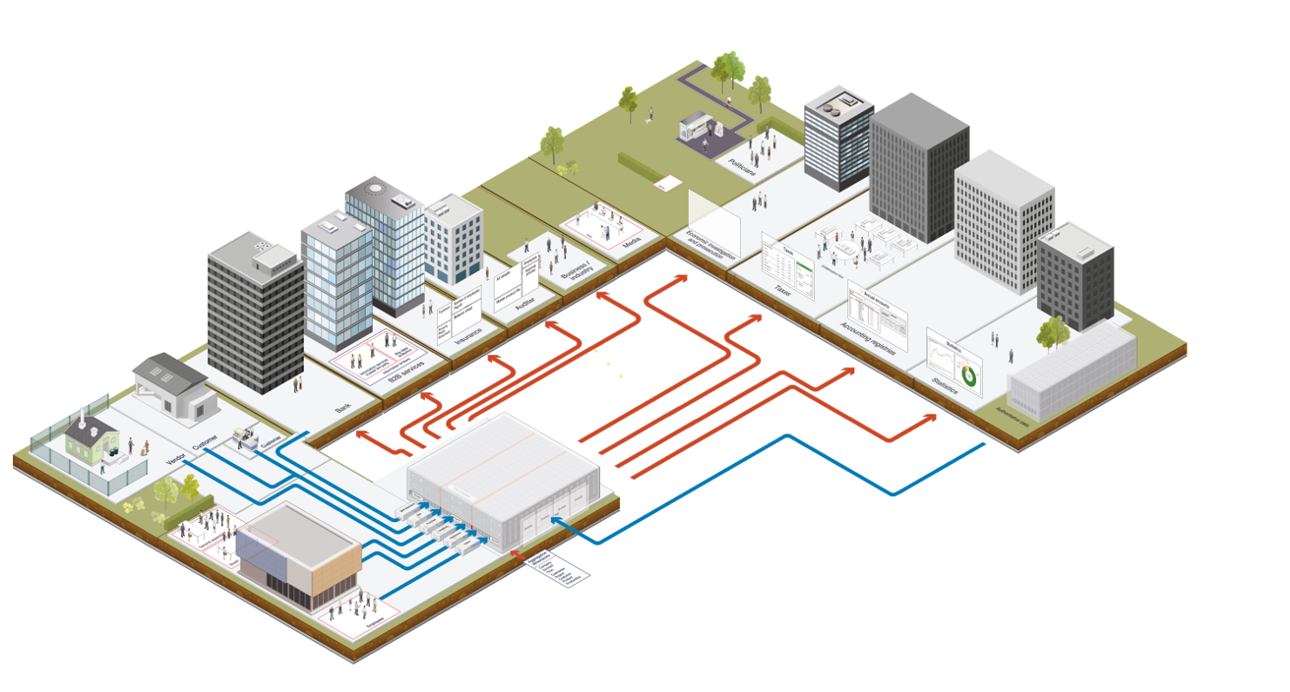
Architectural Overview
12th of February 2020 - Pending review

Slide 2
Content
Executive Summary
Nordic Smart Government ecosystem
Capability & reference architecture hierarchy
Architectural principles
User principles
Bundled actions
Actors & infrastructure with summary
eInvoice
eReceipt
Roles & Mandates
Digital product codes
Business document integrity
Trusted government services for secure business
Application services

Slide 3
Executive summary
The Architecture overview is meant to be a high-level presentation of the necessary architectural building blocks and enablers to support the Nordic Smart Government interoperable ecosystem. This overview is formulated to bind the more detailed architectural documents together and derived from identified architectural capabilities.
It focuses on the collection of application services that organizations share as a set of common goals and collaborate to provide specific services to customers regardless of the technology ownership or operational models and geographical distribution.

Slide 4
The Nordic Smart Government ecosystem
The realization of Nordic Smart Government through an interoperable ecosystem of digital solutions will provide real-time financial data for business-to-business and business-to-government interactions. It will consist of public and private systems handling financial data used by the SME:s in various business systems. Business administration such as transaction processing and reporting to governmental authorities is supported by the ecosystem, as well as access to financial information for business counterparties.
Nordic Smart Goverment
Recognized counterparties:
SME is any entity that engages in business transactions and is required to report it's financial data to Government agencies
Operators deliver information between businesses or to Goverment agencies and are part of standardised data supply chain.
Goverment agencies analyse the business entities data and are resposible for the Economic and financial regulation fulfillment.
Nordic Smart Goverment is the Nordic Information and communication network of Government agencies.
Goverment agencies
Operators
SME’s

Slide 5
Capability / reference architecture hierarchy
Vision
Expected outcomes
Capability map
Reference architecture: application & technical services

Slide 6
Hierarchical capabilities and services (partial example)
Illustrative example of architectural building block fulfilling the capabilities and expected outcomes of the NSG
Vision
The Nordic region shall become the most integrated in the world
Expected outcomes
Make life simpler for SMEs in the Nordic region
Make the Nordic region the most integrated in the world
Increased and more efficient use of financial data in public and private sectors
Capability map
eInvoice standard implemented in all business systems
Receival of eReceipts possible in all business systems
eOrder and eCatalogs implemented in all business systems
VAT automation between businesses and business systems
Common representation of the base registry data on businesses
Reference architecture: Application & technical services map
Compliant with e-ordering and e-cataloging BIS format (semantic model EN-16931)
Product catalogues used with standardized product codes
Access to a service that checks for VAT-registration

Slide 7
Architectural principles in a nutshell
These principles are meant to guide the effort of selecting and implementing the different technical mechanisms that will form the NSG solution.
They may be used as guidelines before selection and/or implementation, or as a checklist after a choice has been made.
Principle 1: Build on open existing standards
Principle 2: Use clearly defined, global semantics
Principle 3: Protect user data
Principle 4: Built to evolve
Principle 5: Use secure building blocks
Principle 6: Enforce data portability

Slide 8
User Principles
The following user principles guide the architectural designing work:
I never manually enter information that is already maintained digitally by someone else, like the producers, vendors or the government
When I buy and sell goods and services I don't need to make any special arrangements when my trade-partners are in another Nordic country
I rarely perform manual steps related to inventory, book-keeping, bank-transactions, VAT- or other government reporting, unless I choose to verify or alter the proposals from my systems
If someone offers me a better deal or improved service, migrating to new service providers for services like bookkeeping, inventory, reporting etc is just as easy as changing operator for my cell phone
I get feedback during processes, and there is someone who can assure me -- as well as my existing and potential trade-partners -- that everything is OK with regards to my duties towards the Government, so I can sleep well at night and go for a holiday without worrying
I am in control of all the transaction and financial data of my business, and empowered to re-use and share the data when I have the need, and I know who is accessing what information, on what legal basis (my consent or government legislation), when and for what purpose
I can pick and choose among the best of breed, and use as many business systems by different providers simultaneously as I like, without having to pay for customized integrations
When I pay for upgrades of my business systems, I expect improved functionality, not just a set of mandatory updates to stay compliant with new and complex requirements from the Government
At any time I have an updated view of the financial situation of the company, including reliable forecasts for the coming weeks, so that I know whether I will be able to pay the salaries or the VAT next week

Slide 9
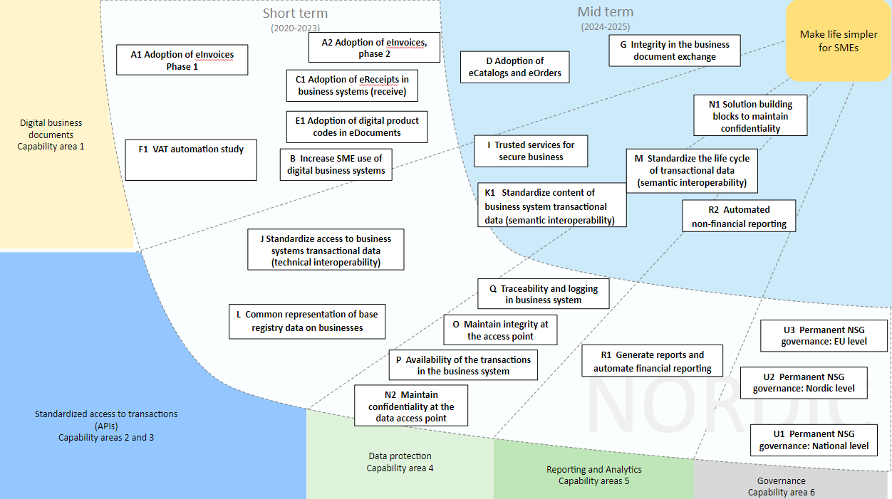
Bundled actions
Actions are bundled into three different phases: short term 2020-2023, mid term 2024-2025 and long term 2026-2027. Short and mid term actions illustrated below:

Slide 10
Actors and infrastructure

Slide 11
Summary of the actors and the infrastructure
The following slides illustrate the logical application services and standards for the actors and infrastructure within the NSG ecosystem.
These illustrations are not meant to be comprehensive blueprints for implementations and there can be other possible solutions for the same needs.
The application services will be realised by concrete physical services. These may be provided by private operators, government agencies and/or be mapped to existing solutions.
Actors and infrastructures have goals and steps that correspond to the actions numbered in the headline. These numbered actions may be found in the Capabilities and business processes of the NSG ecosystem document.
Readiness for adoption indicated on a scale of low-medium-high:
High means that standards and technology exist today, but that implementation is not yet completed Medium means at least one necessary component is missing, but there is a path to implementation Low means that the prerequisites to implementation are ill-defined or difficult to meet

Slide 12
Readiness of eInvoices
Goal
Actions are needed for all business systems to comply with the standards. Suggested standard is Peppol BIS.
Steps
Compliance with eInvoice BIS format
Complete the implementation of the OpenPeppol BIS standard
Market the eInvoice feature to their business system clients
Promote and communicate the benefits to SME’s
Extend the regulation from public procurement to demand sending of invoices from public sector
Create incentives in public procurement
Require that when the customer supports eInvoices, suppliers must sent invoices in that format
Readiness for adoption: High
Existing technical services for einvoicing in general are widely spread
Common standard EN 16931-1 already decided by EU
Possible Applications or technical services required
eInvoice creation service
B2B interface for invoice delivery
eInvoice format translation service
Company ID verification service
eInvoice archiving service
eInvoice routing service
Services for SME’s
Metadata provider service
OpenPeppol BIS standard
Government agency services
Existing fit or partial fit solutions
Further development needed

Slide 13




Readiness of eInvoices (continued): Fully developed eInvoice infrastructure – actions 1.1.1 – 1.1.3 ,1.1.9
OpenPEPPOL network
Service Metadata Locator
AP address lookup
Service Metadata Provider
Seller
capability lookup
Buyer
Business system
EN-16931 eInvoice
Access Point
Access Point
EN-16931 eInvoice
Business system
Provide national SMP
Implement support for PEPPOL BIS specification

Slide 14
Readiness of eReceipt
Goal
A standardized, cross-border network for sending and receiving eReceipts for bookkeeping and auditing purposes.
Steps
Standardize the content of eReceipt
Implement eReceipt in OpenPeppol network, connecting to the PoS
Implement eReceipts in Business systems
Implement mapping and routing from national eReceipts systems to the OpenPeppol network
Mobile payment services send eReceipts
Readiness for adoption: Medium
Several networks exist but interoperability and portability needs to be improved (4-corner model)
eReceipt standardization is ongoing
Possible Application or technical services required
eReceipt creation service
Interface for payment verification
Interface for receipt delivery
eReceipt translation service
eReceipt archiving service
OpenPeppol Network
Services for SME’s
eReceipt routing register
Company ID verfication service
eReceipt standard
Government agency services
Existing fit or partial fit solutions
Further development needed

Slide 15

Readiness of eReceipt (continued): Mapping and routing of eReceipts – action 1.1.15, 1.1.16
Common routing register
eReceipt routing register
Registered as endpoint for this customer
Routing service selected by vendor (there may be many)
Endpoint address for this card/
mobile payment id
Point of Sales system
Cash register
Address lookup
Common specification
card
CARD TOKEN
eReceipt routing service
Buyer
Fetch eReceipt
mobile pay
Business system
Registered as customer
Mobile payment system
MOBILE PAY ID
Automatic bookkeeping
eReceipt archiving service
eReceipt (in format produced by vendor)
CEN/PEPPOL BIS eReceipt
eReceipt standard
Format?
eReceipt translation service
PEPPOL network
Marked as business expense account? <forward>
ARTS-DR or other
CEN/PEPPOL BIS eReceipt

Slide 16
Readiness of Digital Product codes
Goal
There are various codes that can be used, e.g. EAN code, EU Harmonized System codes, or other standard product and service category codes (UNSPC for example)
Steps
Include and process product information/codes in the business documents
Discover product information/codes and access services providing additional information about the product.
Ordering systems must provide product codes
Enforce the use of product codes in the supply chain
Enforce a best practice for use of product codes in eInvoicing
Readiness for adoption: Low
There is a plethora of product code standards and registries, with different uses and scope
Harmonization requires a lot of work
Possible Application or technical services required
eInvoice creation service
Interface for payment verification
GS1 product registry
Services for SME’s
eReceipt creation service
Product registry lookup
Customs product code registry
Statistic categories registry
Government agency services
Stadardized API product access
Existing fit or partial fit solutions
Further development needed

Slide 17
Readiness of Digital Product codes (continued): Product information lookup – action 1.2.5
Seller
Buyer
Specific product data needed, eg. fire safety classification.
eInvoice:
- product ID - product registry ID
Business system
PEPPOL network
Business system
Common lookup register
Product registry lookup
1. Find endpoint of registry from central lookup
Common API specification
Product information registry, id GS1
Product information registry, id CAS
Product information registry, id XYZ
2. Get data using standardized API

Slide 18
Readiness of Business Document immutability
Goal
Ensure integrity for business documents and prevent tampering
Prevent illicit double use of business documents
Steps
Provide access to digital business documents validation services that check that necessary contents are present and used codes etc. are correct
Provide services that register usage of business documents (eg. eReceipts) in order to make sure that a document is only used once. This enables automated checks (based on hash calculations)
Ready for adoption: medium
Existing solution for signing and validation exist and emerging technologies are maturing
Common services and interoperability is missing
Possible Application or technical services required
Product code validation service
Hash verfication service
Automated document check engine
Services for SME’s
Business document validation service
Document signing service
Peppol document validation service
Hash Database
Hash-calculation service
Government agency services
Existing fit or partial fit solutions
Further development needed

Slide 19


Readiness of Business Document immutability (continued): Business document immutability – action 1.3.2
Seller
(Alternative transport methods)
Buyer
eInvoice
PEPPOL network
eInvoice
Business system
Business system
eInvoice hash
eInvoice hash
Business document immutability service
Is this eInvoice unchanged?
Has this eInvoice been claimed as expense more than once?
Auditor
Tax agency
Hash database
Common API specification

Slide 20
Readiness of Store references to documents
Goal
Using digital proofs of transaction instead of current process of storing paper vouchers for a number of years as a copy for both parties of the business transaction
Steps
Enforce a system where sales documents are not sent at all, but stored in one place and being referenced. Eliminates the challenges of having different copies at each end
Legal changes to remove the need to store and archive copies of business documents
Ready for adoption: low
The Nordic countries have different legal requirements in this area and some allow changing of documents after transmission
There are technical solutions for secure off-site storage, eg. in distributed networks, but standards are lacking
Possible Application or technical services required
Document storage
Digital transaction validation
Document store API
Services for SME’s
Document standard
Common API specification
Government agency services
Existing fit or partial fit solutions
Further development needed

Slide 21
Readiness of Store references to documents (continued): action 1.3.3
Buyer
Seller
(Alternative transport method)
Invoice reference + address
Business system
eInvoice
PEPPOL network
Business system
Store with third party
Retrieve
Common API specification
Retrieve for audit
Document archiving service
Auditor
Invoice

Slide 22
Trusted government services for secure business
Goal
SME may need to or want to perform various checks to ensure that the trading partner exists, is registered for VAT and has payed taxes.
Steps
Access to a service that checks the validity of a bank account number against the company number
Access to a service that checks for VAT-registration
Access to a service that checks the “seriousness” of a company (taxes paid, VAT paid, annual accounts delivered)
Access to a service that checks that trading partners really exist before sending documents (is registered in business registries)
Access to a service that provides a warning function related to well known "fraud companies" or the bank account number that is used could also be relevant.
Implement warning services for factual events about a company (gov. data: forced proceedings, persons not allowed to do business)
Ready for adoption: high
Common Nordic business registry lookups and API's are missing which are technically quick to implement
Connecting the data points with validation and lookup services can be used to provide legitimacy checks
Possible Application or technical services required
Business registry API
Tax registry whitelist
Fraud warning service
Services for SME’s
Bank account validation service
Company rating service
Government API lookup service
Common Business registry lookup
Government agency services
Existing fit or partial fit solutions
Further development needed

Slide 23


Trusted government services for secure business (continued) – action 1.3.6 – 1.3.8
Government API lookup service
Common lookup service
Seller
Buyer
Business system
Address lookup
Common specifications
Address lookup
Business system
Is seller registered for VAT?
Has buyer paid taxes?
Is buyer undergoing reconstruction?
Tax agency
Business registry
Tax agency
Business registry

Slide 24
Readiness for Business system API and eAddressing
Goal
Enable standardized ways for integration while supporting portability of business data without customization
Steps
a standardized service, API, for accessing transactional data from a business
a (standardized) role based authorization service for the businesses to grant access to different parties to read/write data
implement a standardized format for transferring detailed bookkeeping data between systems (portability)
Ready for adoption: low
Bookkeeping standards are implemented by the business systems, but implementation is nation-specific and not Nordic.
Lack of a common chart of accounts hampers portability
Common business services are not fully interoperable and need further development in services supporting portability
Possible Application or technical services required
Common Business API lookup
eAddress registry
Transaction API
Services for SME’s
Authorization service
Bookkeeping stardards
Common CoA
Business Transactions API
Government agency services
Existing fit or partial fit solutions
Further development needed

Slide 25


Business system API and eAddressing (continued) – action 2.1.1, 2.2.2
Common lookup service
Business system API lookup service
Business API address lookup
Common specification
Business
Get aggregate information for due diligence purposes
Business system
Get transactions for audit
Access granted by business owner
Tax agency

Slide 26
Powers and mandates
Goal
Authentication of an information consumer in a business system is necessary to make sure that only an intended consumer gets access to the system and information within
Steps
Provide authorization by power of mandates
Provide authorization through user’s consent in B2B
Provide authentication of a company (eID for businesses)
Ready for adoption: medium
Multiple different national registeries exist but they are not consolidated on a Nordic level
Further development of fommon services is needed for seamless verification of powers and mandates in the Nordics - lookup and verification services
Possible Application or technical services required
User consent service
P&M registry
lookup
Role & rights mgmt service
Services for SME’s
Mandate verification API
P&M registry
eID registry
Government agency services
Existing fit or partial fit solutions
Further development needed

Slide 27


Powers and mandates – action 2.1.2
Common specification and infrastructure
eIDAS Infrastructure
Identified by
Identified by
Powers and Mandates registry
Powers and mandates registry lookup service
1. Give mandate to bank
Bank officer
Entrepreneur
5. Confirm mandate to release information
3. Get mandate
2. Get address to P&M registry
Business system
4. Request information
Business
Common specification
Common lookup service

